Slide 1
Airbnb Investment in Amsterdam, Netherland
By K. Wei Shen
September 2021

Slide 2
Overview
Objective:
To Invest AirBnB business in Amsterdam by exploring historical result.
To validate AirBnB business opportunity.
Scope
Review revenue generated by successful host.
Review property types with most positive reviews.
Review neighborhoods with most listing.
Review neighborhoods with most positive reviews.
Strategy
Vertical Chevron List.

Slide 3

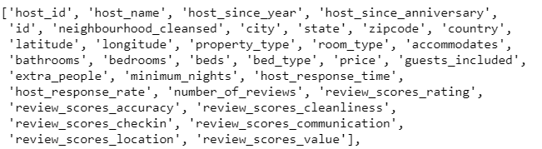
Dataset Background
EDA on (Airbnb Data (Mini Project 1).xlsx)
Quantity of Clean Data
Type of data point
Host Age
Eldest : 2008/8/11 (13 Yrs till today)
Youngest : 2015/4/4 (6 Yrs till today)
No Duplicate Data
No Empty Review Data

Slide 4
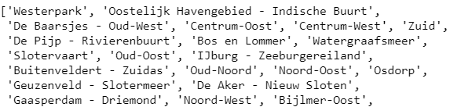
Background and dataset
Total 22 Neighborhoods
Total 14 types of property

Slide 5
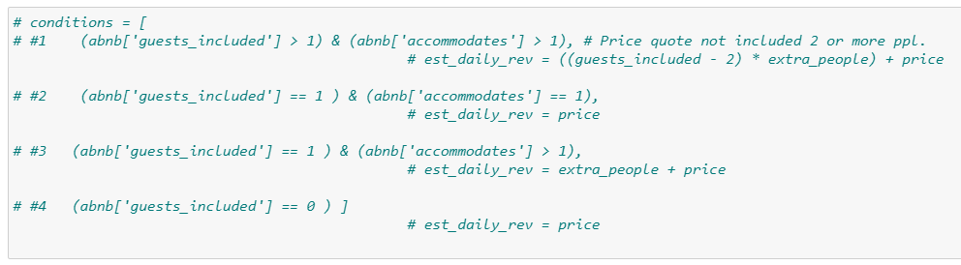
Revenue Concept
Each Booking for 2 Guests

Slide 6
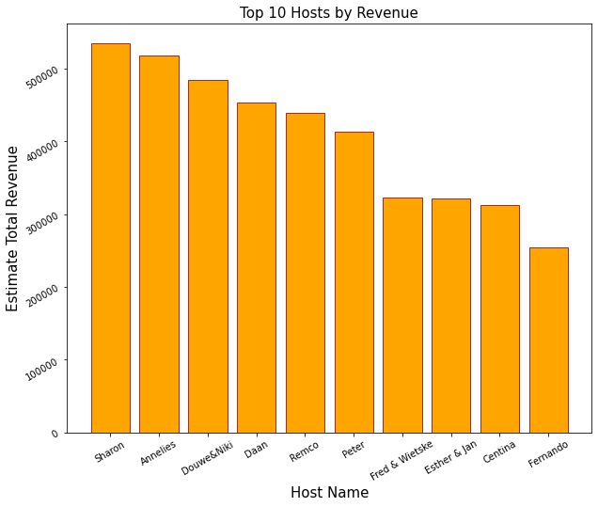
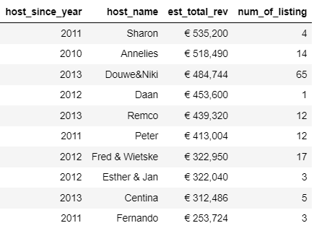
Revenue Generated by Successful Host

Slide 7
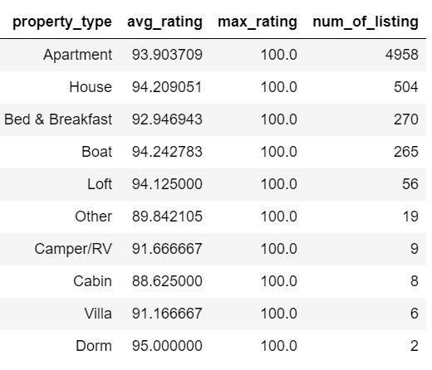
Property Types Receive The Most Positive Reviews

Slide 8
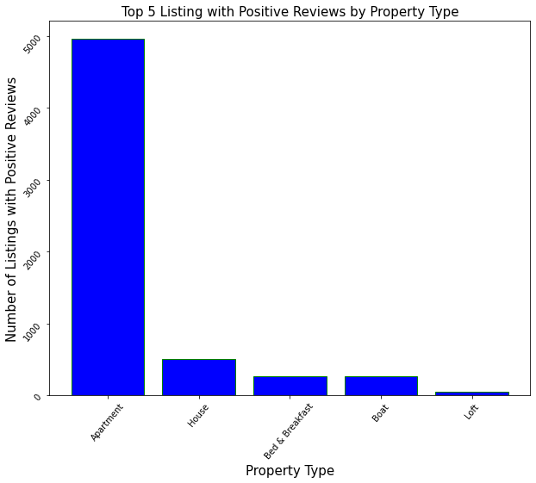
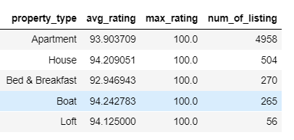
Property Types Receive The Most Positive Reviews

Slide 9
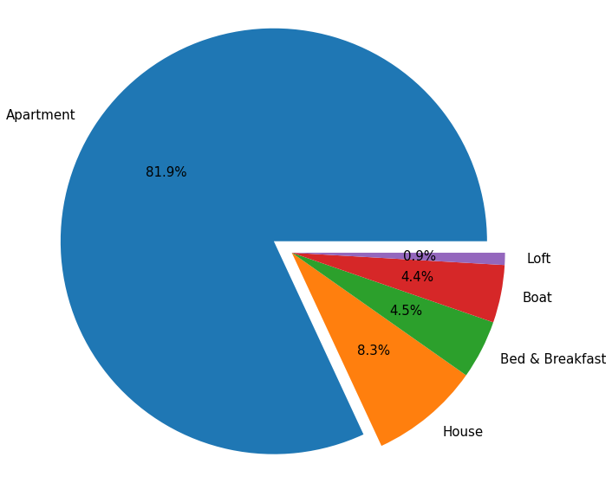
Property Types Receive The Most Positive Reviews

Slide 10
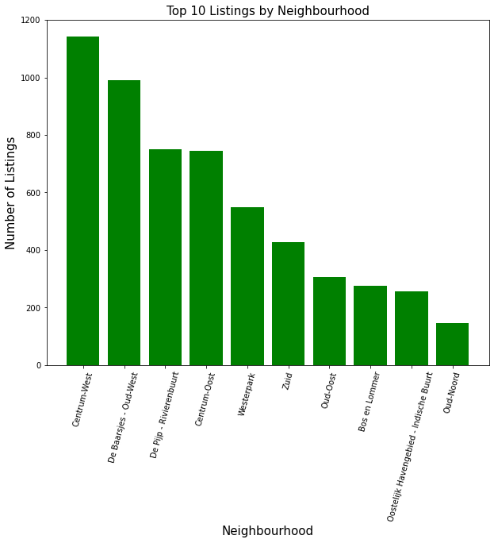
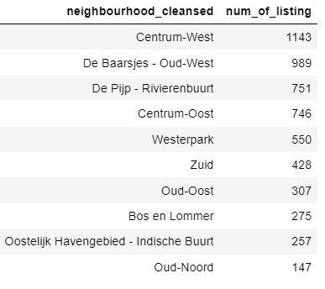
Neighborhoods with Most Listing

Slide 11
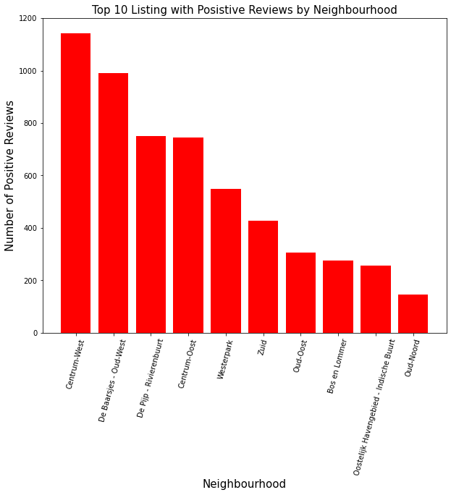
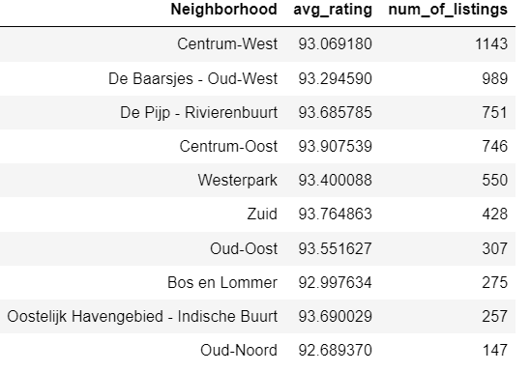
Neighborhoods with Most Positive Reviews.

Slide 12
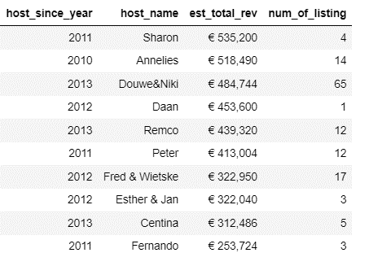
Summary
WHAT’s NEXT

Slide 13


Strategy
Centrum
West
Apartment
2 Bedrooms
Air Bed
$160-$200

Slide 14
Target Revenue
€440,000 ~
€ 550,000
Listings:
15 ~ 60

Slide 15
~THE END~

